Slide 1
HASHING!

Slide 2
Instructor
Dr. Ab Rouf Khan
Assistant Professor
VIT Bhopal University

Slide 3
Entry level Questions
How can we implement the dictionaries efficiently for various operations – insert, delete, search, etc.?
Is there any Searching technique having the worst case time complexity of O(1)?
How to resolve the collisions?

Slide 4
Outline (Module 4 [Part 2])
Hashing
Introduction
Hash Tables
Hash Functions
Division Modulo Method, Digit Extraction Method, Fold Shifting Method, Mid Square Method, etc.
Collison Resolution Techniques in Hashing
Chaining
Open Addressing
Linear probing
Quadratic Probing
Double Hashing

Slide 5
Concept of Hashing
In CS, a hash table, or a hash map, is a data structure that associates keys (names) with values (attributes).
Look-Up Table
Dictionary
Cache
Extended Array

Slide 6
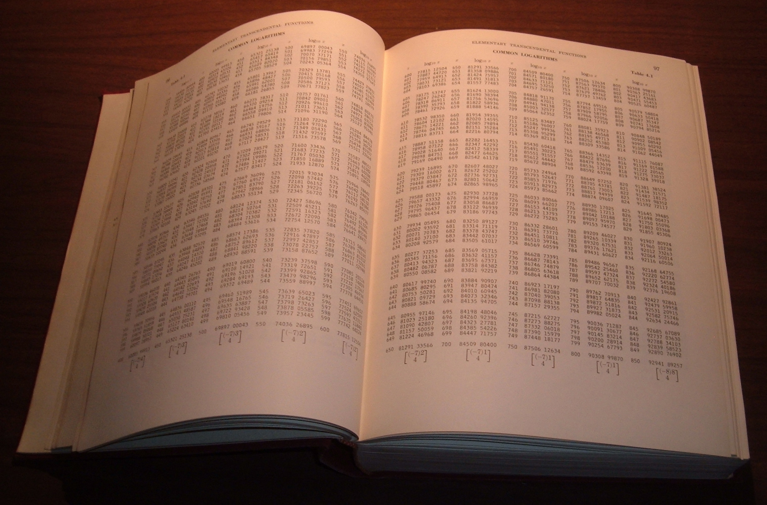
Tables of logarithms

Slide 7
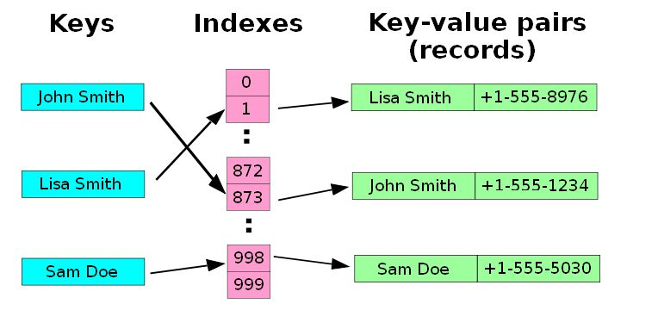
Example
A small phone book as a hash table.
(Figure is from Wikipedia)

Slide 8
Dictionaries
Collection of pairs.
(key, value)
Each pair has a unique key.
Operations.
Get(theKey)
Delete(theKey)
Insert(theKey, theValue)

Slide 9
Just An Idea
Hash table :
Collection of pairs,
Lookup function (Hash function)
Hash tables are often used to implement associative arrays,
Worst-case time for Get, Insert, and Delete is O(size).
Expected time is O(1).

Slide 10
Search vs. Hashing
Search tree methods: key comparisons
Time complexity: O(size) or O(log n)
Hashing methods: hash functions
Expected time: O(1)
Types
Static hashing
Dynamic hashing

Slide 11
Static Hashing
Key-value pairs are stored in a fixed size table called a hash table.
A hash table is partitioned into many buckets/slots.
Each slot holds one record.
A hash function f(x) transforms the identifier (key) into an address in the hash table.

Slide 12
So, what really a hash table is?
Data structure that offers very fast insertion and searching, almost O(1).
Relatively easy to program as compared to trees.
Based on arrays, hence difficult to expand.
No convenient way to visit the items in a hash table in any kind of order.

Slide 13
Hash Tables
Constant time accesses!
A hash table is an array of some fixed size, usually a prime number.
General idea:
hash table
0
 | …
hash function:
h(K)
key space (e.g., integers, strings)
TableSize –1

Slide 14
Hash Table
Key idea is that instead of direct mapping, Hash Tables use a Hash Function h to map each input key to a unique location in table of size M
h : U -> {0, 1, …, M-1}
hash function determines the hash table size.
Desiderata:
M should be small, O(n)
h should be easy to compute
Typical example: h(i) = i mod M

Slide 15
Hash Table Example (1)
key space = integers
TableSize = 10
Hash Function – h(K) = K mod 10
Insert: 7, 18, 41, 94
0
1
2
3
4
5
6
7
8
9

Slide 16
Hash Table Example (2)
key space = integers
TableSize = 6
h(K) = K mod 6
Insert: 7, 18, 41, 34
0
1
2
3
4
5
Notes:
7 (6*1 = 6)->1, 18-> 0, 41(6*6=36) -> 5, 34 (5*6)=30-> 4
Q: Why don’t we just create a table of size 100, or 40 and just map them directly to location?
A: Assumption is key space is much larger than the number of values we have to insert. (Ex. Using social security # as the key to put students in this class in a hash table. Table of size 999,999,999??)
Q: How long does that take to insert? O(1)
Q: How do we find them?
Q: How long does that take?
Q: What if we insert 12? (It wants to go in location 0 – CONFLICT)

Slide 17
Hashing : the basic idea
9
10
20
39
4
14
8
Student Records
Perm # (mod 9)

Slide 18
Hashing
0
U
(universe of keys)
h(k₁)
h(k₄)
K
(actual
keys)
k₁
k₄
k₂
collision
h(k₂)=h(k₅)
k₅
k₃
h(k₃)
m–1

Slide 19
Hashing: The Basic Setup
Choose a pseudo-random hash function h
this automatically determines the hash table size.
An item with key k is put at location h(k).
To find an item with key k, check location h(k).

Slide 20
So, what really hashing is?
A range of key values can be transformed into a range of array index values.
A Searching Technique
Aims at searching a give element in the O(1) time.
Goal of hashing – O(1) search time in worst case!

Slide 21
Choice of Hash Function
Requirements
easy to compute
minimal number of collisions
If a hashing function groups key values together, this is called clustering of the keys.
A good hashing function distributes the key values uniformly throughout the range.

Slide 22
Some hash functions
Middle of square (Mid-Square)
H(x):= return middle digits of x^2
Division Modulo
H(x):= return x % k
Multiplicative
H(x):= return the first few digits of the fractional part of x*k, where k is a fraction.
advocated by D. Knuth in TAOCP vol. III.

Slide 23
Some hash functions II
Digit Folding
Partition the identifier x into several parts, and add the parts together to obtain the hash address
e.g. x=12320324111220; partition x into 123,203,241,112,20; then return the address 123+203+241+112+20=699
Shift folding vs. folding at the boundaries
Digit analysis
If all the keys have been known in advance, then we could delete the digits of keys having the most skewed distributions, and use the rest digits as hash address.

Slide 24
Hashing By Division Modulo Method (1)
Domain is all integers.
For a hash table of size b, the number of integers that get hashed into bucket i is approximately 2³²/b.
The division method results in a uniform hash function that maps approximately the same number of keys into each bucket.

Slide 25
Hashing By Division Modulo Method II
In practice, keys tend to be correlated.
If divisor is an even number, odd integers hash into odd home buckets and even integers into even home buckets.
20%14 = 6, 30%14 = 2, 8%14 = 8
15%14 = 1, 3%14 = 3, 23%14 = 9
If divisor is an odd number, odd (even) integers may hash into any home.
20%15 = 5, 30%15 = 0, 8%15 = 8
15%15 = 0, 3%15 = 3, 23%15 = 8

Slide 26
Hashing By Division Modulo Method III
Similar biased distribution of home buckets is seen in practice, when the divisor is a multiple of prime numbers such as 3, 5, 7, …
The effect of each prime divisor p of b decreases as p gets larger.
Ideally, choose large prime number b.
Alternatively, choose b so that it has no prime factors smaller than 20.

Slide 27
Issues with Hashing
Multiple keys can hash to the same slot – collisions are possible.
Design hash functions such that collisions are minimized.
But avoiding collisions is impossible.
Design collision-resolution techniques.
Search will cost Ө(n) time in the worst case.
However, all operations can be made to have an expected complexity of Ө(1).

Slide 28
Methods of Collison Resolution
Chaining:
Store all elements that hash to the same slot in a linked list.
Store a pointer to the head of the linked list in the hash table slot.
Open Addressing:
All elements stored in hash table itself.
When collisions occur, use a systematic (consistent) procedure to store elements in free slots of the table.
0
k₁
k₄
k₅
k₂
k₆
k₇
k₃
k₈
m–1

Slide 29
Collision Resolution by Chaining (Example 1)
0
U
(universe of keys)
h(k₁)=h(k₄)
X
k₁
k₄
K
(actual
keys)
k₂
k₆
X
h(k₂)=h(k₅)=h(k₆)
k₅
k₈
k₇
k₃
X
h(k₃)=h(k₇)
h(k₈)
m–1

Slide 30
Collision Resolution by Chaining (Example 1)
0
U
(universe of keys)
k₁
k₄
k₁
k₄
K
(actual
keys)
k₂
k₆
k₅
k₂
k₆
k₅
k₈
k₇
k₃
k₇
k₃
k₈
m–1

Slide 31
Collision Resolution by Chaining (Example 2)
Maintain a list of all elements that hash to the same value
Search using the hash function to determine which list to traverse
Insert/deletion–once the “bucket” is found through Hash, insert and delete are list operations
0
1
2
3
4
5
6
7
8
9
10
23
1
56
24
36
14
16
17
find(k,e) HashVal = Hash(k,Hsize); if (TheList[HashVal].Search(k,e)) then return true; else return false;
7
29
31
20
42
class HashTable { …… private: unsigned int Hsize; List<E,K> *TheList; ……
Notes:
Hash function is x mod 11

Slide 32
Collision Resolution by Chaining (Example 2)
Insert 53
53 = 4 x 11 + 9
53 mod 11 = 9
0
1
2
3
4
5
6
7
8
9
10
0
1
2
3
4
5
6
7
8
9
10
23
1
56
23
1
56
24
24
36
14
36
14
16
16
17
17
7
29
7
29
31
20
42
53
20
42
31

Slide 33
Analysis of Hashing with Chaining
Worst case
All keys hash into the same bucket
a single linked list.
insert, delete, find take O(n) time.
Average case
Keys are uniformly distributed into buckets
Load Factor, L = InputSize/HashTableSize
In a failed search, avg cost is L
In a successful search, avg cost is 1 + L/2

Slide 34
Open addressing
If collision happens, alternative cells are tried until an empty cell is found.
Different probing strategies
Linear
Quadratic
Double Hashing
0
1
2
3
4
5
6
7
8
9
10
42
1
24
14
16
28
7
31
9

Slide 35
Linear Probing (insert 12)
12 = 1 x 11 + 1
12 mod 11 = 1
0
1
2
3
4
5
6
7
8
9
10
42
0
1
2
3
4
5
6
7
8
9
10
42
1
1
24
24
14
14
12
16
16
28
28
7
7
31
31
9
9

Slide 36
Search with linear probing (Search 15)
15 = 1 x 11 + 4
15 mod 11 = 4
0
1
2
3
4
5
6
7
8
9
10
42
1
24
14
12
16
28
7
NOT FOUND !
31
9

Slide 37
Search with linear probing
// find the slot where searched item should be in
int HashTable<E,K>::hSearch(const K& k) const
{
int HashVal = k % D;
int j = HashVal;
do {// don’t search past the first empty slot (insert should put it there)
if (empty[j] || ht[j] == k) return j;
j = (j + 1) % D;
} while (j != HashVal);
return j; // no empty slot and no match either, give up
}
bool HashTable<E,K>::find(const K& k, E& e) const
{
int b = hSearch(k);
if (empty[b] || ht[b] != k) return false;
e = ht[b];
return true;
}

Slide 38
Deletion in Hashing with Linear Probing
Since empty buckets are used to terminate search, standard deletion does not work.
One simple idea is to not delete, but mark.
Insert: put item in first empty or marked bucket.
Search: Continue past marked buckets.
Delete: just mark the bucket as deleted.

Slide 39
Deletion with linear probing: LAZY (Delete 9)
9 = 0 x 11 + 9
9 mod 11 = 9
0
1
2
3
4
5
6
7
8
9
10
42
0
1
2
3
4
5
6
7
8
9
10
42
1
1
24
24
14
14
12
12
16
16
28
28
7
7
31
31
FOUND !
D
9

Slide 40
Problem of Linear Probing
Identifiers tend to cluster together (Primary Clustering)
Adjacent cluster tend to coalesce
Increase the search time

Slide 41
Quadratic Probing
Solves the Primary clustering problem in Linear Probing
Check H(x) – (Hash (x))
If collision occurs check H(x) + 1
If collision occurs check H(x) + 4
If collision occurs check H(x) + 9
If collision occurs check H(x) + 16
...
Hash Function: H(x) + i²

Slide 42
Quadratic Probing (insert 12)
12 = 1 x 11 + 1
12 mod 11 = 1
0
1
2
3
4
5
6
7
8
9
10
42
0
1
2
3
4
5
6
7
8
9
10
42
1
1
24
24
14
14
12
16
16
28
28
7
7
31
31
9
9

Slide 43
Double Hashing
When collision occurs use a second hash function
Hash₂ (x) = R – (x mod R)
R: greatest prime number smaller than table-size
Inserting 12
H₂(x) = 7 – (x mod 7) = 7 – (12 mod 7) = 2
Check H(x)
If collision occurs check H(x) + 2
If collision occurs check H(x) + 4
If collision occurs check H(x) + 6
If collision occurs check H(x) + 8
Hash Function: H(x) + i * H₂(x)

Slide 44
Double Hashing (insert 12)
12 = 1 x 11 + 1
12 mod 11 = 1
7 –12 mod 7 = 2
0
1
2
3
4
5
6
7
8
9
10
42
0
1
2
3
4
5
6
7
8
9
10
42
1
1
24
24
14
14
12
16
16
28
28
7
7
31
31
9
9

Slide 45
Rehashing
If table gets too full, operations will take too long.
Build another table, twice as big (and prime).
Next prime number after 11 x 2 is 23
Insert every element again to this table
Rehash after a percentage of the table becomes full (70% for example)

Slide 46
Collision Hash Functions
H_{i}(x)= (H(x)+i) mod B
Linear probing
H_{i}(x)= (H(x)+c*i) mod B (c > 1)
Linear probing with step-size = c
H_{i}(x)= (H(x)+i²) mod B
Quadratic probing
H_{i}(x)= (H(x)+ i * H₂(x)) mod B
Double Hashing

Slide 47
Analysis of Open Hashing
Effort of one Insert?
Intuitively – that depends on how full the hash is
Effort of an average Insert?
Effort to fill the Bucket to a certain capacity?
Intuitively – accumulated efforts in inserts
Effort to search an item (both successful and unsuccessful)?
Effort to delete an item (both successful and unsuccessful)?
Same effort for successful search and delete?
Same effort for unsuccessful search and delete?

Slide 48
Issues: Hashing
What do we lose?
Operations that require ordering are inefficient
FindMax: O(n) O(log n) Balanced binary tree
FindMin: O(n) O(log n) Balanced binary tree
PrintSorted: O(n log n) O(n) Balanced binary tree
What do we gain?
Insert: O(1) O(log n) Balanced binary tree
Delete: O(1) O(log n) Balanced binary tree
Find: O(1) O(log n) Balanced binary tree
How to handle Collision?
Separate chaining
Open addressing

Slide 49
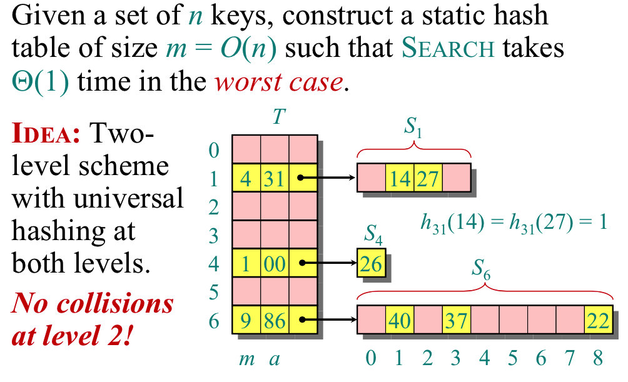
Perfect Hashing: Worst-Case O(1) Lookup

Slide 50

Recap

Slide 51
Thank You

